Slide 1


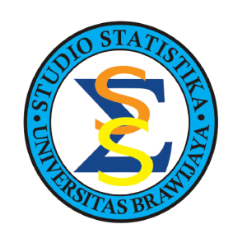


K Means Clustering

Slide 2
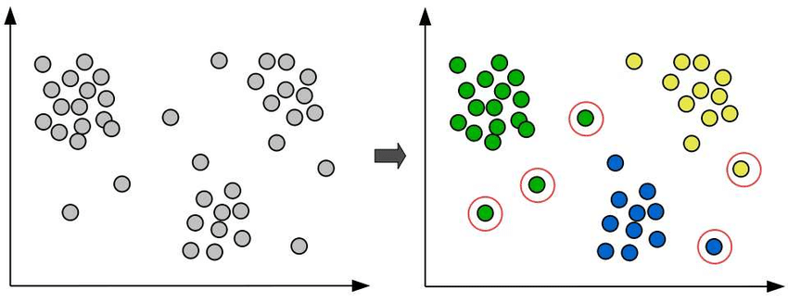
Apa itu Clustering?
Clustering adalah tugas membagi titik-titik data ke dalam beberapa kelompok sedemikian sehingga titik-titik data dalam kelompok yang sama lebih mirip dengan titik-titik data lain dalam kelompok yang sama dibandingkan dengan titik-titik data dalam kelompok lain.

Slide 3
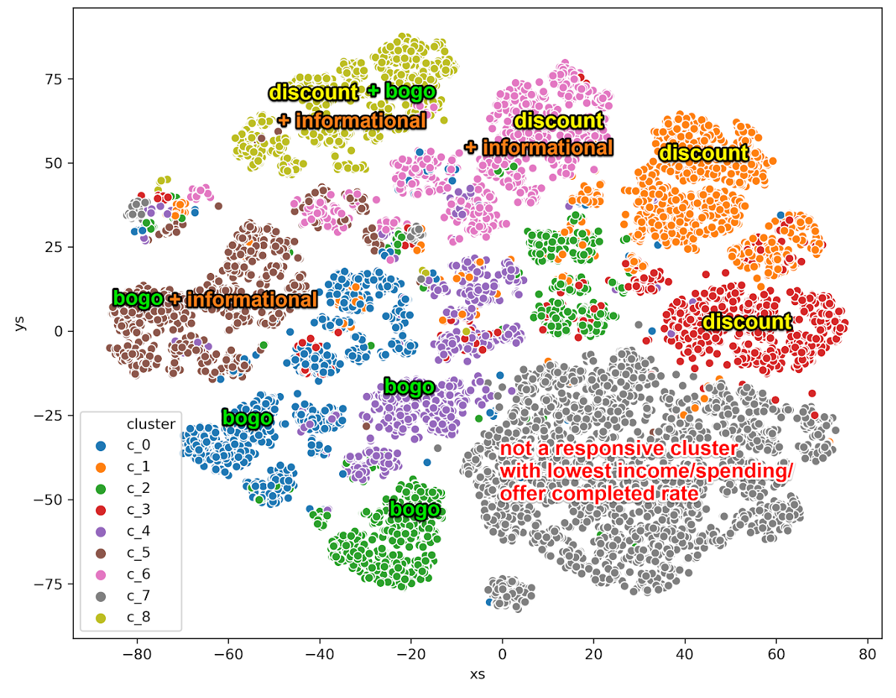
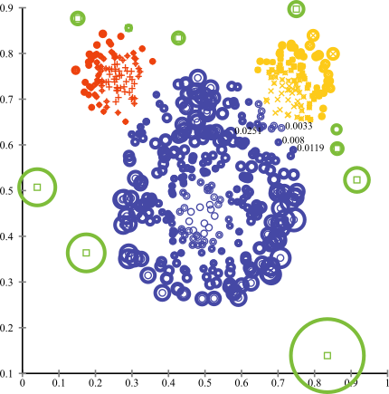
Clustering di Industry
Customer Segmentation
Anomaly Detection

Slide 4

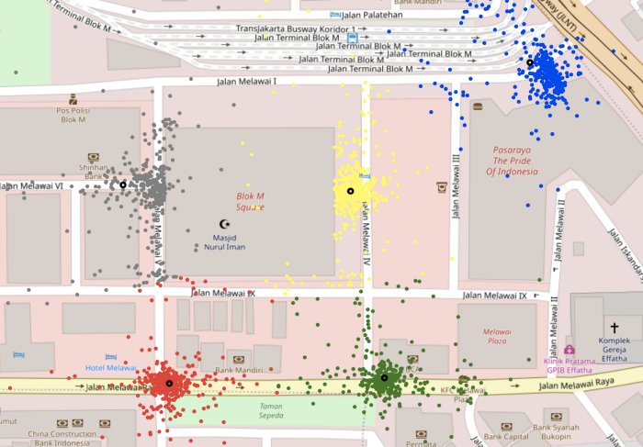
Clustering in Industry
Customer Segmentation in Gojek
https://blog.gojek.io/fantastic-drivers-and-how-to-find-them/

Slide 5
Clustering Step
Feature extraction and selection
Clustering algorithm design
Result Evaluation
Result Explanation

Slide 6
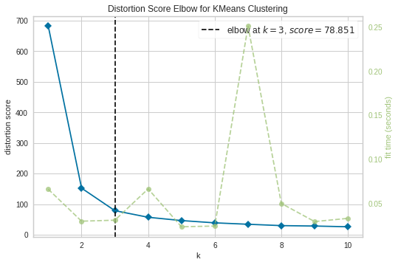
Get the Recommended Number of Clusters
Distortion: It is calculated as the average of the squared distances from the cluster centers of the respective clusters. Typically, the Euclidean distance metric is used.

Slide 7
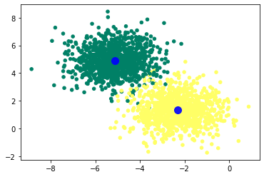
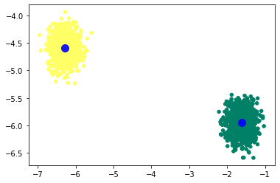
Cluster Evaluation
Which one is ideally better?

Slide 8
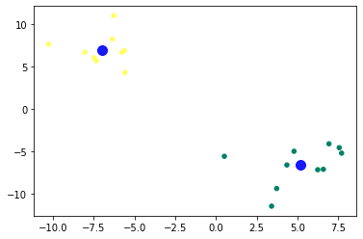
Cluster Evaluation
Indeks DBI
Indeks Davies–Bouldin (DBI) (diperkenalkan oleh David L. Davies dan Donald W. Bouldin pada tahun 1979), metrik untuk mengevaluasi algoritma pengelompokan, adalah skema evaluasi internal, di mana validasi seberapa baik pengelompokan telah dilakukan dibuat. menggunakan jumlah dan fitur yang melekat pada dataset.
Semakin rendah nilai indeks DB, semakin baik clusteringnya. Ini juga memiliki kekurangan. Nilai bagus yang dilaporkan oleh metode ini tidak menyiratkan pengambilan informasi terbaik.
adalah jarak antar cluster yaitu jarak antara cluster Xi dan Xj
adalah jarak intracluster dari cluster Xk yaitu jarak dalam cluster Xk

Slide 9
Analysis of K Means Clustering
1. K Means clustering in action

Slide 10
Analysis of K Means Clustering
2. Why use the K Means Clustering method?
K Means is the most popular method
SSE function on K Means is proven towards Local Optimum
Has certain advantages

Slide 11
Analysis of K Means Clustering
3. Strengh of K Means Clustering
Easy to understand and implement
Efficient in time complexity, O(tkn); n=number of data, k=number of clusters, t=number of iterations
As long as k and t are small numbers, k means is a linear algorithm

Slide 12
Analysis of K Means Clustering
3. Weakness of K Means Clustering
This algorithm can only be applied if the mean is well defined, this means that the k-means method can only be used on numerical data, for categorical data it can use K-mode, where the center of the cluster is represented as the data that occurs most often.
The cluster form is only spherical (because it is a partition method)
User need to specify k first
This algorithm is sensitive to outliers (Because it uses the Mean)

Slide 13
Thank You …

